Slide 1





A digital twin for intelligent surfaces aided cellular network infrastructures leveraging
Intelligent Reconfigurable Surfaces
Supervisors:
Prof. Chadi Barakat
Prof. Thierry Turletti
Prof. Damien Saucez
Yaacoub YAACOUB

Slide 2
Plan
Introduction – Motivation
IRS Working Principle
Designing Our IRS Model
Model Results
Future Work

Slide 3
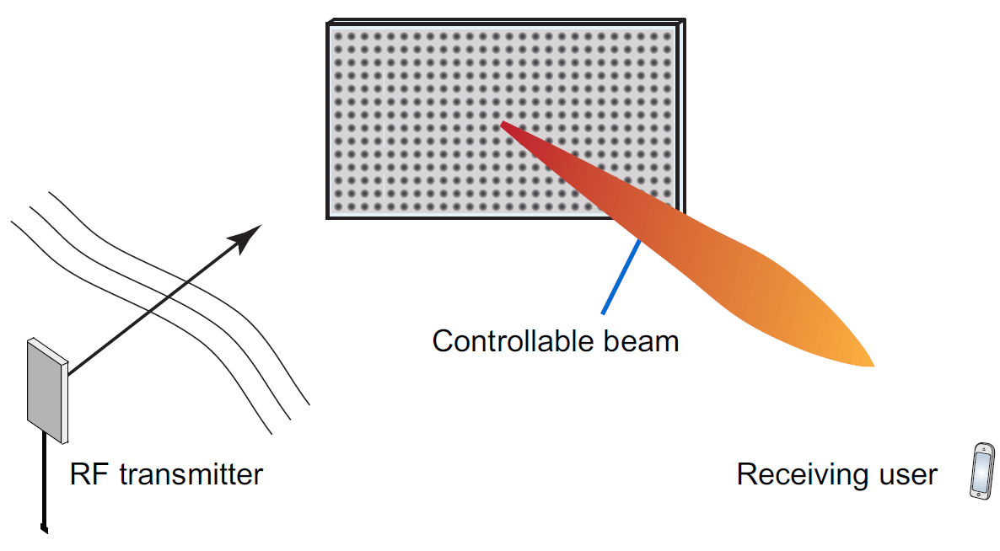
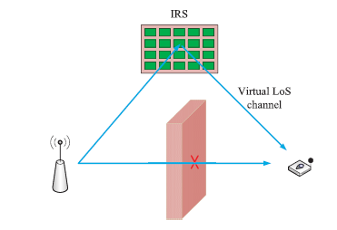
Introduction
Network deployed with higher frequencies [1]
Making the wireless environment programmable and controllable [1]
Increase spectral and energy efficiency for wireless communications [3]
Creating Virtual Line of sight between transmitter and receiver when a real LOS does not exist [2]
Main advantages of the IRS:
Reduce power transmitted by the base station [1]
Reduce the number of base stations deployed [1]
[2]
[1] M. Di Renzo et al., “Smart Radio Environments Empowered by Reconfigurable Intelligent Surfaces: How It Works, State of Research, and the Road Ahead,” IEEE J. Sel. Areas Commun., vol. 38, no. 11, pp. 2450–2525, 2020.
[2] Q. Wu, S. Zhang, B. Zheng, C. You, and R. Zhang, “Intelligent Reflecting Surface-Aided Wireless Communications: A Tutorial,” IEEE Trans. Commun., vol. 69, no. 5, pp. 3313–3351, 2021.
[3] H. Zhang and B. Di, “Reconfigurable Intelligent Surfaces Assisted Communications With Limited Phase Shifts : How Many Phase Shifts Are Enough ?,” IEEE Trans. Veh. Technol., vol. 69, no. 4, pp. 4498–4502, 2020.
3

Slide 4
Metasurfaces Types
Passive Surfaces
No power amplification
Minimal digital signal processing
Minimal Power consumption for the configuration phase
Passive Reflection beamforming
Active Surfaces
Capability of generation and reception of radio signals
Requires an active RF chain per active antenna element
Active transmission beamforming
[M. Di Renzo et al., “Smart Radio Environments Empowered by Reconfigurable Intelligent Surfaces: How It Works, State of Research, and the Road Ahead,” IEEE J. Sel. Areas Commun., vol. 38, no. 11, pp. 2450–2525, 2020.
4

Slide 5
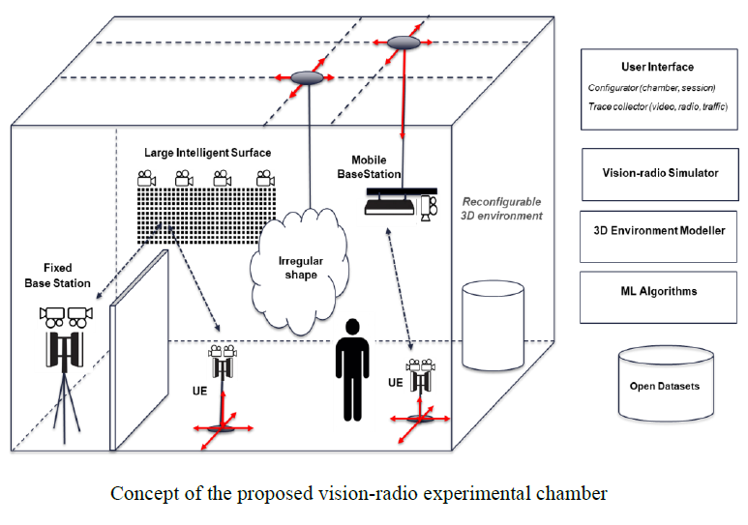
A digital twin for intelligent surfaces aided cellular network infrastructures
Experimental chamber
Building a toolset combining radio and vision-based communications and sensing technologies
“view-to-communicate and communicate-to-view”
A 3D-digital twin used to validate the proof-of-concept results of experiments
“CONVERGE – Telecommunications and Computer Vision Convergence Tools for Research Infrastructures,”
5

Slide 6
Plan
Introduction – Motivation
IRS Working Principle
Designing Our IRS Model
Model Results
Future Work

Slide 7
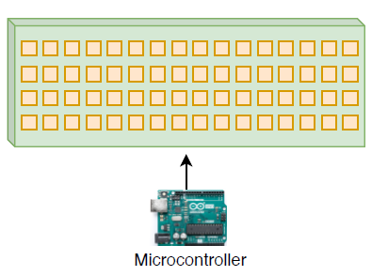
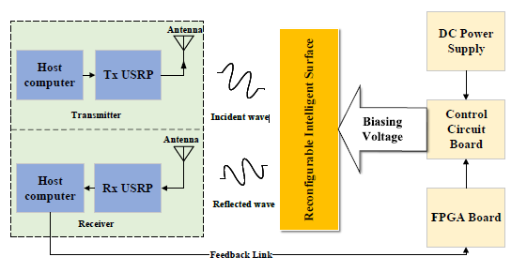
Intelligent Reconfigurable Surface
[3]
Inexpensive adaptive surface
Surface divided into large number of small element
Element size < λ
Elements controlled independently
Low power usage for operation
Elements consists of Varactor Diodes or PIN Diodes
[2]
[1] M. Di Renzo et al., “Smart Radio Environments Empowered by Reconfigurable Intelligent Surfaces: How It Works, State of Research, and the Road Ahead,” IEEE J. Sel. Areas Commun., vol. 38, no. 11, pp. 2450–2525, 2020.
[2] X. Pei et al., “RIS-Aided Wireless Communications : Prototyping , Adaptive Beamforming , and Indoor / Outdoor Field Trials,” pp. 1–13.
[3] E. Basar et al., “Reconfigurable Intelligent Surfaces,” IEEE Access, vol. PP, no. June 2018, p. 1, 2019.
7

Slide 8
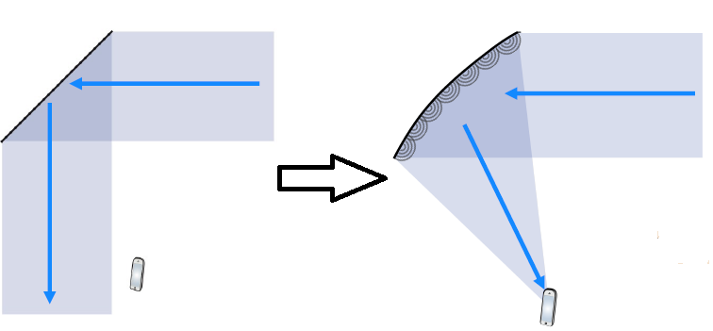
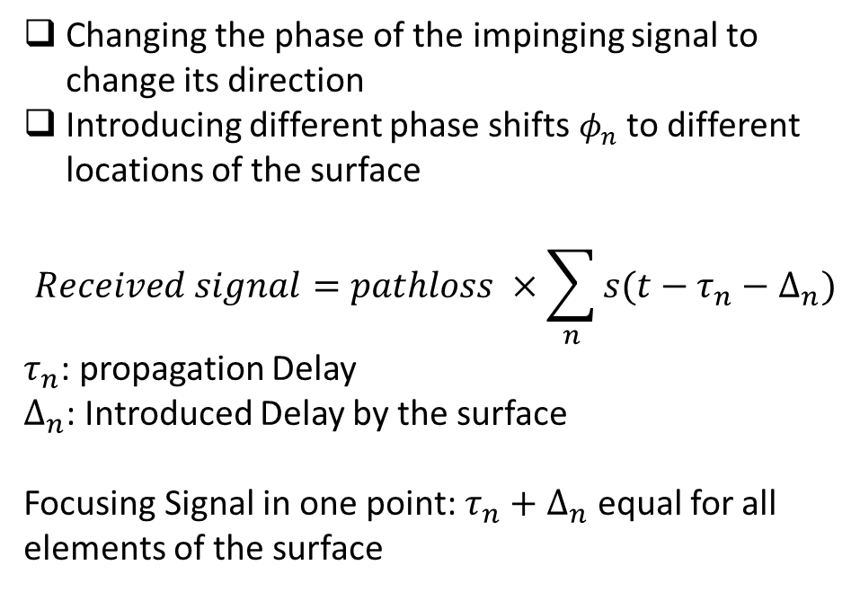
IRS Main Working Principle
Changing the phase of the impinging signal to change its direction
Introducing different phase shifts $φ_{n}$ to different locations of the surface
$$Received signal=pathloss ×\sum_{n}{s(t−τ_{n}−∆_{n})}$$
$τ_{n}$: propagation Delay
$∆_{n}$: Introduced Delay by the surface
Focusing Signal in one point: $τ_{n}+∆_{n}$ equal for all elements of the surface
[1]
[1] E. Bjornson, H. Wymeersch, B. Matthiesen, P. Popovski, L. Sanguinetti, and E. De Carvalho, “Reconfigurable Intelligent Surfaces: A signal processing perspective with wireless applications,” IEEE Signal Process. Mag., vol. 39, no. 2, pp. 135–158, 2022.
8

Slide 9
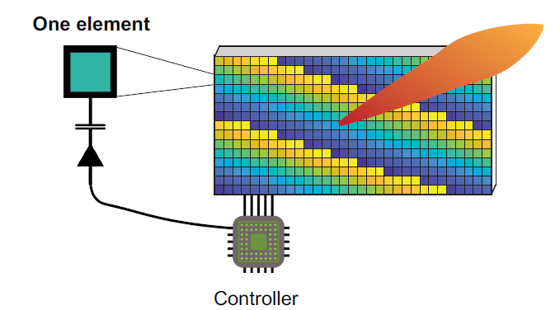
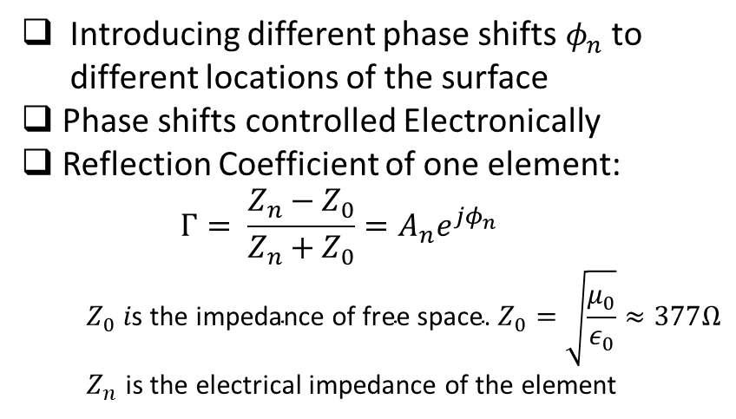
IRS Main Working Principle
Introducing different phase shifts $φ_{n}$ to different locations of the surface
Phase shifts controlled Electronically
Reflection Coefficient of one element:
$$Γ= \frac{Z_{n}−Z_{0}}{Z_{n}+Z_{0}}=A_{n}e^{jφ_{n}}$$
$$Z_{0} i\text{s} \text{the} \text{impedance} \text{of} \text{free} \text{space}\text{. }Z_{0}=\sqrt{\frac{μ_{0}}{ε_{0}}}≈377Ω$$
$Z_{n}$ is the electrical impedance of the element
S. Abeywickrama, S. Member, R. Zhang, and Q. Wu, “Intelligent Reflecting Surface : Practical Phase Shift,” vol. 68, no. 9, 2020.
9

Slide 10
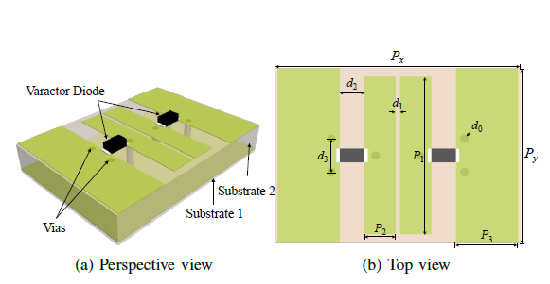
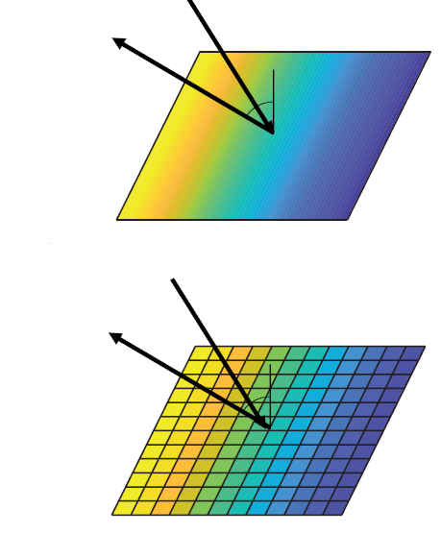
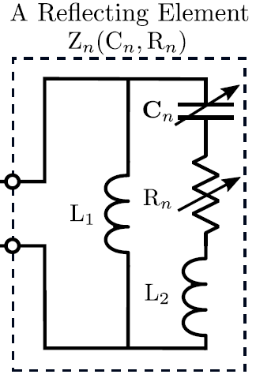
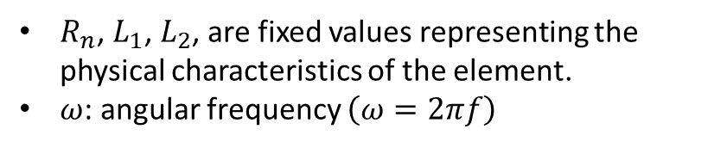
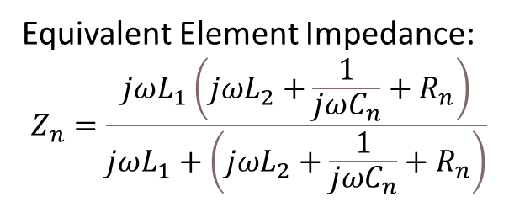
Varactor Model
Phase shift of an element controlled by a varying capacitance
More continuous and uniform phase shifts will be formed
[2]
Equivalent Element Impedance:
$$Z_{n}=\frac{jωL_{1}\left(jωL_{2}+\frac{1}{jωC_{n}}+R_{n}\right)}{jωL_{1}+\left(jωL_{2}+\frac{1}{jωC_{n}}+R_{n}\right)}$$
$R_{n}$, $L_{1}$, $L_{2}$, are fixed values representing the physical characteristics of the element.
$ω$: angular frequency $\left(ω=2πf\right)$
[1]
[1] S. Abeywickrama, S. Member, R. Zhang, and Q. Wu, “Intelligent Reflecting Surface : Practical Phase Shift,” vol. 68, no. 9, 2020.
[2] X. Pei et al., “RIS-Aided Wireless Communications : Prototyping , Adaptive Beamforming , and Indoor / Outdoor Field Trials,” pp. 1–13.
10

Slide 11
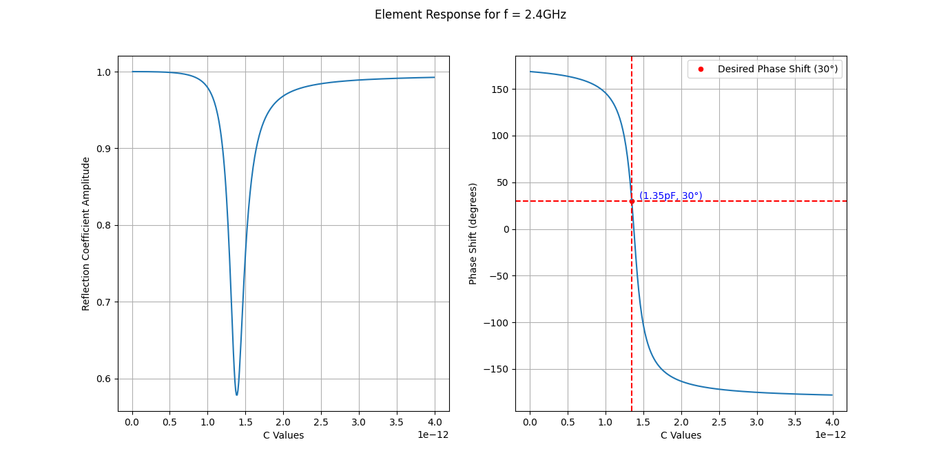
Varactor Model
[1]
11
[1] X. Pei et al., “RIS-Aided Wireless Communications : Prototyping , Adaptive Beamforming , and Indoor / Outdoor Field Trials,” pp. 1–13.

Slide 12
Plan
Introduction – Motivation
IRS Working Principle
Designing Our IRS Model
Model Results
Future Work

Slide 13
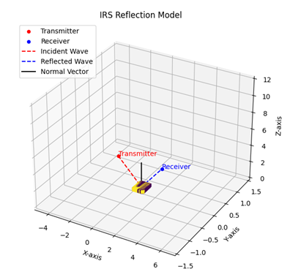
Designing Our IRS Model
Inputs:
Transmitter coordinates
Receiver coordinates
Transmitted Signal
Carrier Frequency f (in Hz)
Amplitude A_i (in V)
Phase φ_i (in rad)
Outputs:
Phase shift of every element of the IRS
The power received
13

Slide 14
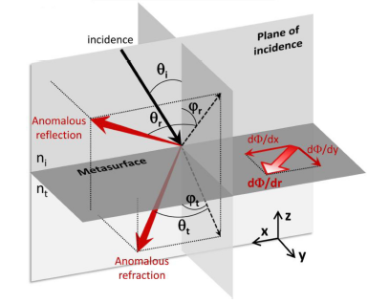
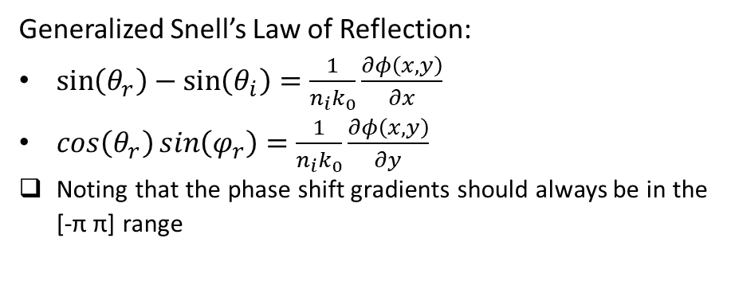
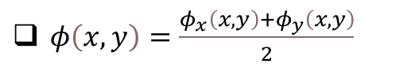
Designing Our IRS Model
Generalized Snell’s Law of Reflection:
$\sin\left(θ_{r}\right)−\sin\left(θ_{i}\right)=\frac{1}{n_{i}k_{0}}\frac{∂φ\left(x, y\right)}{∂x}$
$\cos\left(θ_{r}\right)\sin\left(φ_{r}\right)=\frac{1}{n_{i}k_{0}}\frac{∂φ\left(x, y\right)}{∂y}$
Noting that the phase shift gradients should always be in the [-π π] range
Estimate the function $φ\left(x, y\right)$ from derivatives $\frac{∂φ}{∂x}\left(x, y\right)$ and $\frac{∂φ}{∂y}\left(x, y\right)$
$φ\left(x, y\right)=\frac{φ_{x}\left(x, y\right)+φ_{y}\left(x, y\right)}{2}$
[1]
14
[1] N. Yu et al., “Flat Optics : Controlling Wavefronts With Optical Antenna Metasurfaces,” vol. 19, no. 3, 2013.

Slide 15
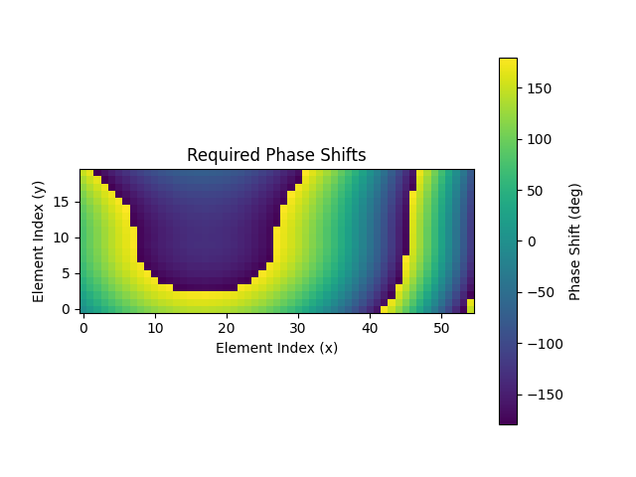
Designing Our IRS Model
[1]
15
[1] N. Yu et al., “Flat Optics : Controlling Wavefronts With Optical Antenna Metasurfaces,” vol. 19, no. 3, 2013.

Slide 16
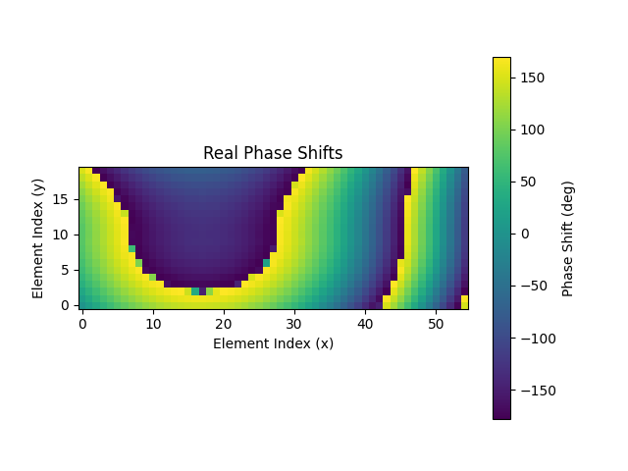
IRS Model Validation
Estimate the Capacitance needed from the varactor
Calculate back the real phase shifts implemented on the surface
16

Slide 17
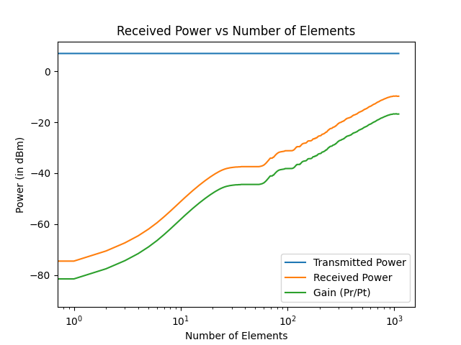
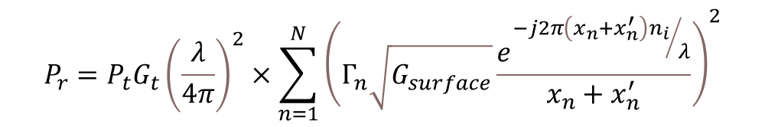
IRS Power Model
Using Friis transmission equation.
Assuming no direct line of sight between the Transmitter and the receiver
Adding up at the receiver location the power collected by each element, while removing erroneous reflections
$$P_{r}=P_{t}G_{t}{\left(\frac{λ}{4π}\right)}^{2}×\sum_{n=1}^{N}{{\left(Γ_{n}\sqrt{G_{surface}}\frac{e^{{−j2π\left(x_{n}+x_{n}^{′}\right)n_{i}}/λ}}{x_{n}+x_{n}^{′}}\right)}^{2}}$$
17

Slide 18
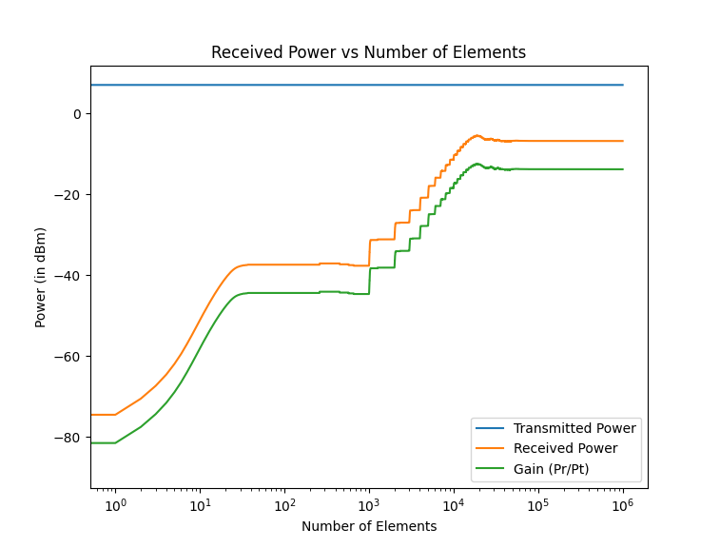
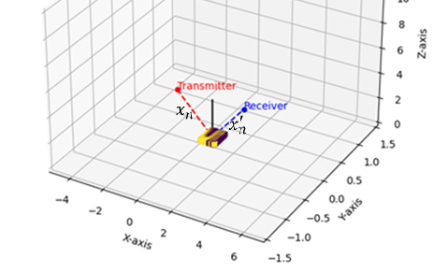
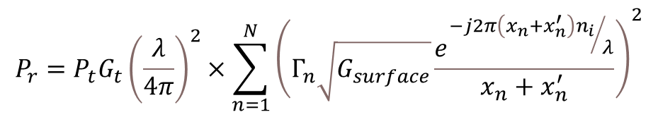
IRS Power Model
$$P_{r}=P_{t}G_{t}{\left(\frac{λ}{4π}\right)}^{2}×\sum_{n=1}^{N}{{\left(Γ_{n}\sqrt{G_{surface}}\frac{e^{{−j2π\left(x_{n}+x_{n}^{′}\right)n_{i}}/λ}}{x_{n}+x_{n}^{′}}\right)}^{2}}$$
18

Slide 19
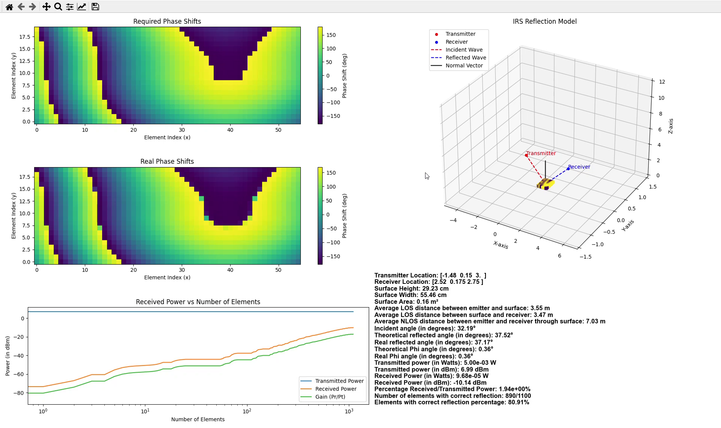
IRS Model Results
19

Slide 20
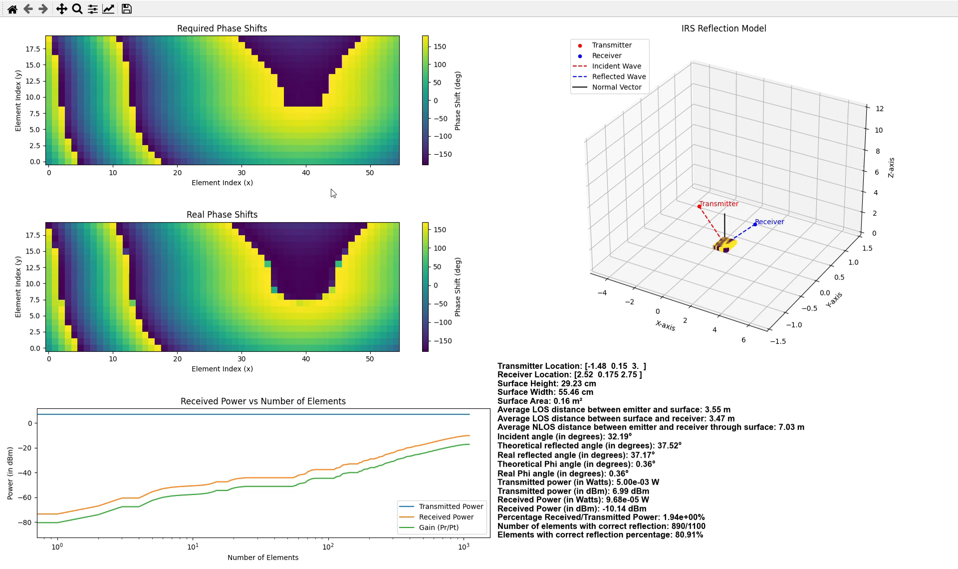
IRS Model Results
20

Slide 21
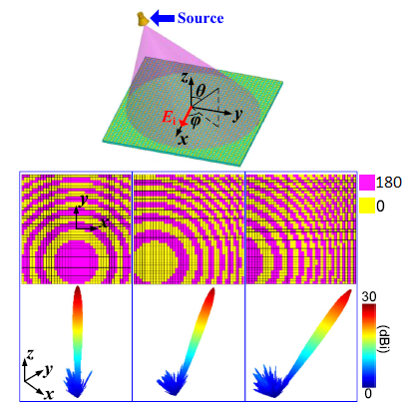
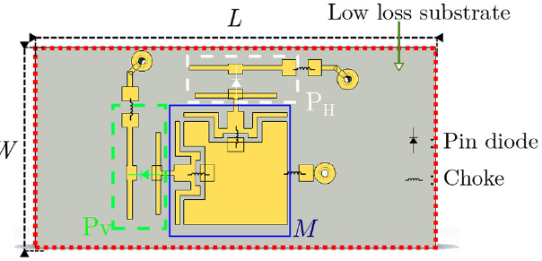
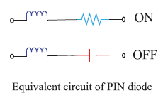
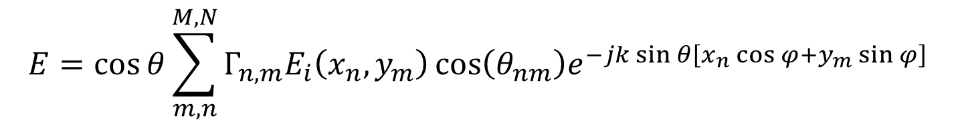
Future Work – Modeling PIN Diode Model
$$E=\cos{θ}\sum_{m,n}^{M,N}{Γ_{n,m}E_{i}\left(x_{n},y_{m}\right)\cos\left(θ_{nm}\right)e^{−jk\sin{θ\left[x_{n}\cos{φ}+y_{m}\sin{φ}\right]}}}$$
[2]
[1]
[1] H. Yang, X. Cao, F. Yang, J. Gao, S. Xu, and M. Li, “OPEN A programmable metasurface with dynamic polarization , scattering and focusing control,” Nat. Publ. Gr., no. October, pp. 1–11, 2016.
[2] R. Fara, P. Ratajczak, A. Ourir, M. Di Renzo, and J. De Rosny, “6G : THE PARADIGM FOR FUTURE WIRELESS COMMUNICATIONS A Prototype of Reconfigurable Intelligent Surface with Continuous Control of the Reflection Phase,” no. February, pp. 70–77, 2022.
21

Slide 22
Thank You
22

Slide 23
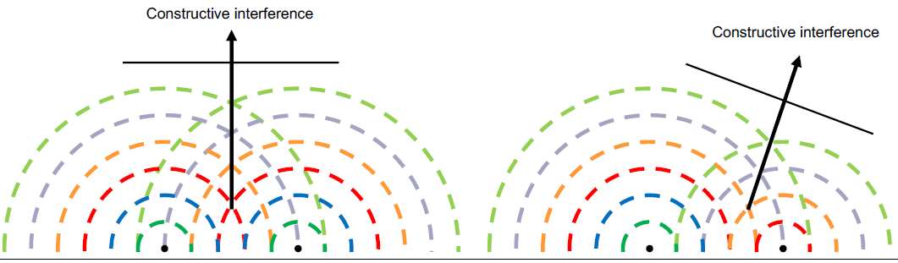
PIN Diode Model
Discrete phase shifts based on diodes states
Discrete elements impedance values, depending on the element architecture and diode state
[1]
[1] R. Fara, P. Ratajczak, A. Ourir, M. Di Renzo, and J. De Rosny, “6G : THE PARADIGM FOR FUTURE WIRELESS COMMUNICATIONS A Prototype of Reconfigurable Intelligent Surface with Continuous Control of the Reflection Phase,” no. February, pp. 70–77, 2022.
23

Slide 24
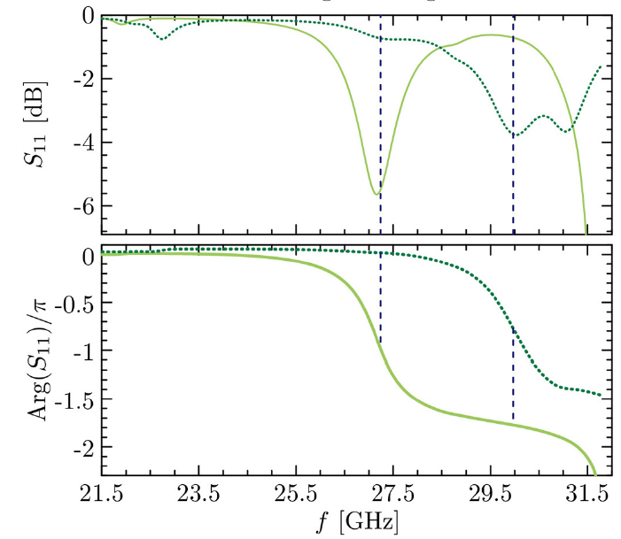
PIN Diode Model
[1]
[1]
[1] R. Fara, P. Ratajczak, A. Ourir, M. Di Renzo, and J. De Rosny, “6G : THE PARADIGM FOR FUTURE WIRELESS COMMUNICATIONS A Prototype of Reconfigurable Intelligent Surface with Continuous Control of the Reflection Phase,” no. February, pp. 70–77, 2022.
24

